Slide 1


Slide 2
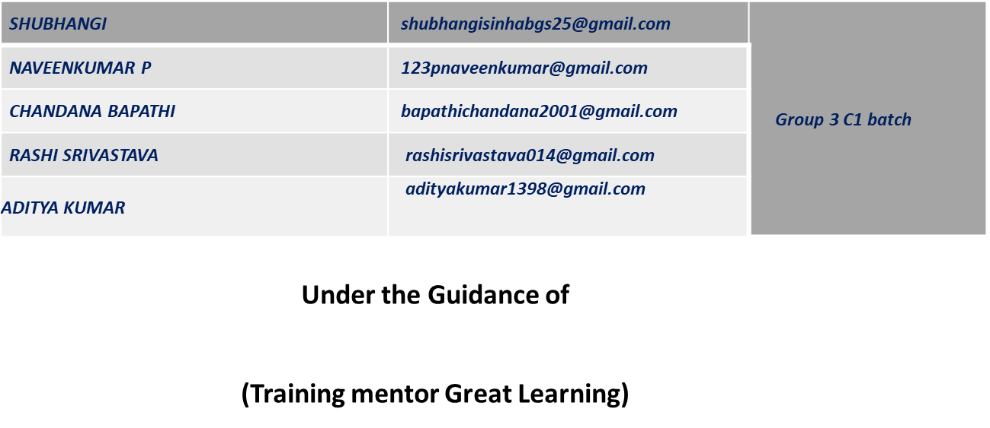
CAPSTONE PROJECT
HOMENIQUE (Shop For Home)
Submitted by:

Slide 3
Homenique
Make Over the Top, they say your style chooses you.

Slide 4
Introduction
Homenique is an Angular, Java Spring Boot and PostgreSQL based application project focused on managing the online shopping platform for the Home-decor and household items . The main purpose for developing this project is to manage home decor item, category, company, order, sales etc. There are two categories of user available first one is admin and second one is user. Admin can add, manage and can also track every single details occurring. Users can order,wishlist and track products according to their requirements.

Slide 5

Technologies Used

Slide 6
System Specifications
Software requirements
Hardware requirements
Technologies:
Angular
Java Spring Boot
Languages:
Typescript
Java
SQL Queries
IDE:
Eclipse
Vs code
Postgresql
Operating System:
Windows 7/8/10/11
Linux distros
MacOS X or later
Processor:
Intel or AMD dual core x86 processor
RAM:
2 Gb or above
Hard disk:
500 MB of free disk space or more

Slide 7
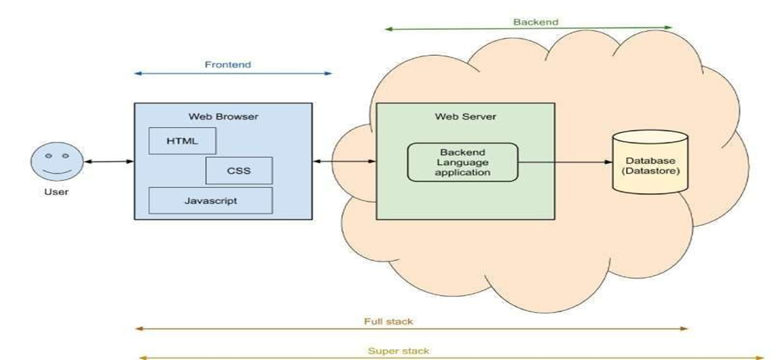

Project Overview

Slide 8
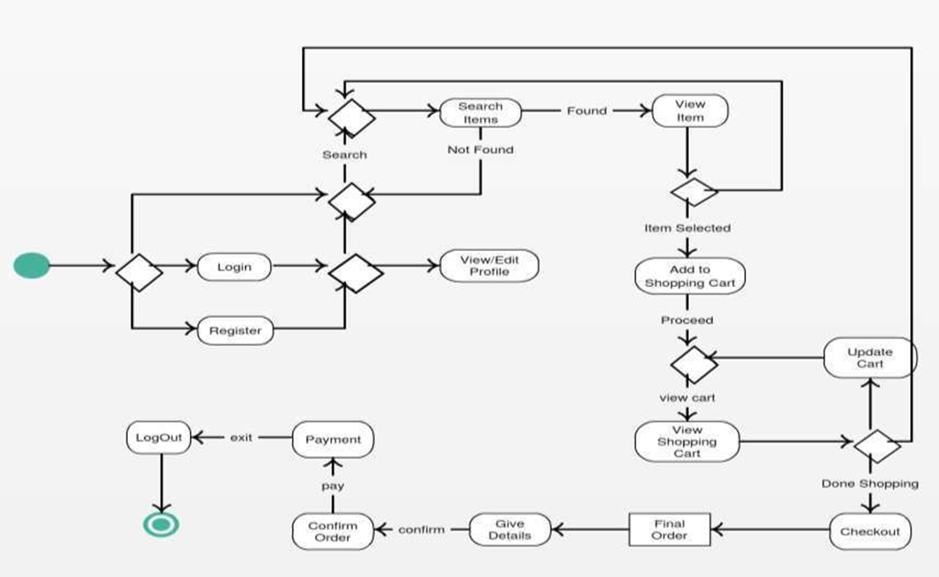
State Chart Diagram

Slide 9
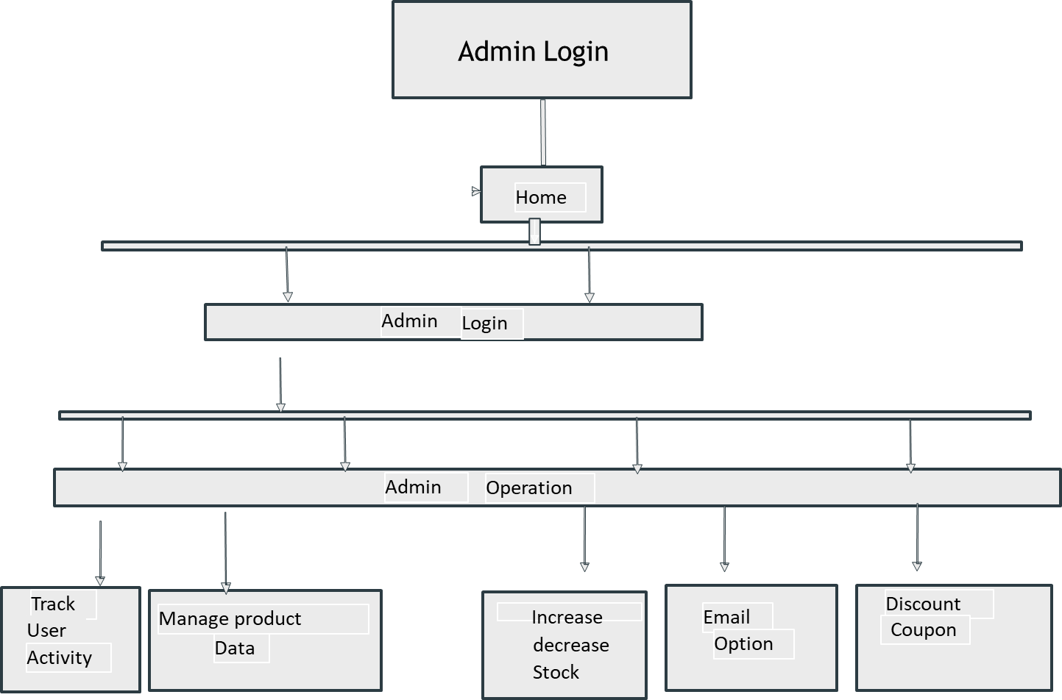
Admin Login Flowchart

Slide 10
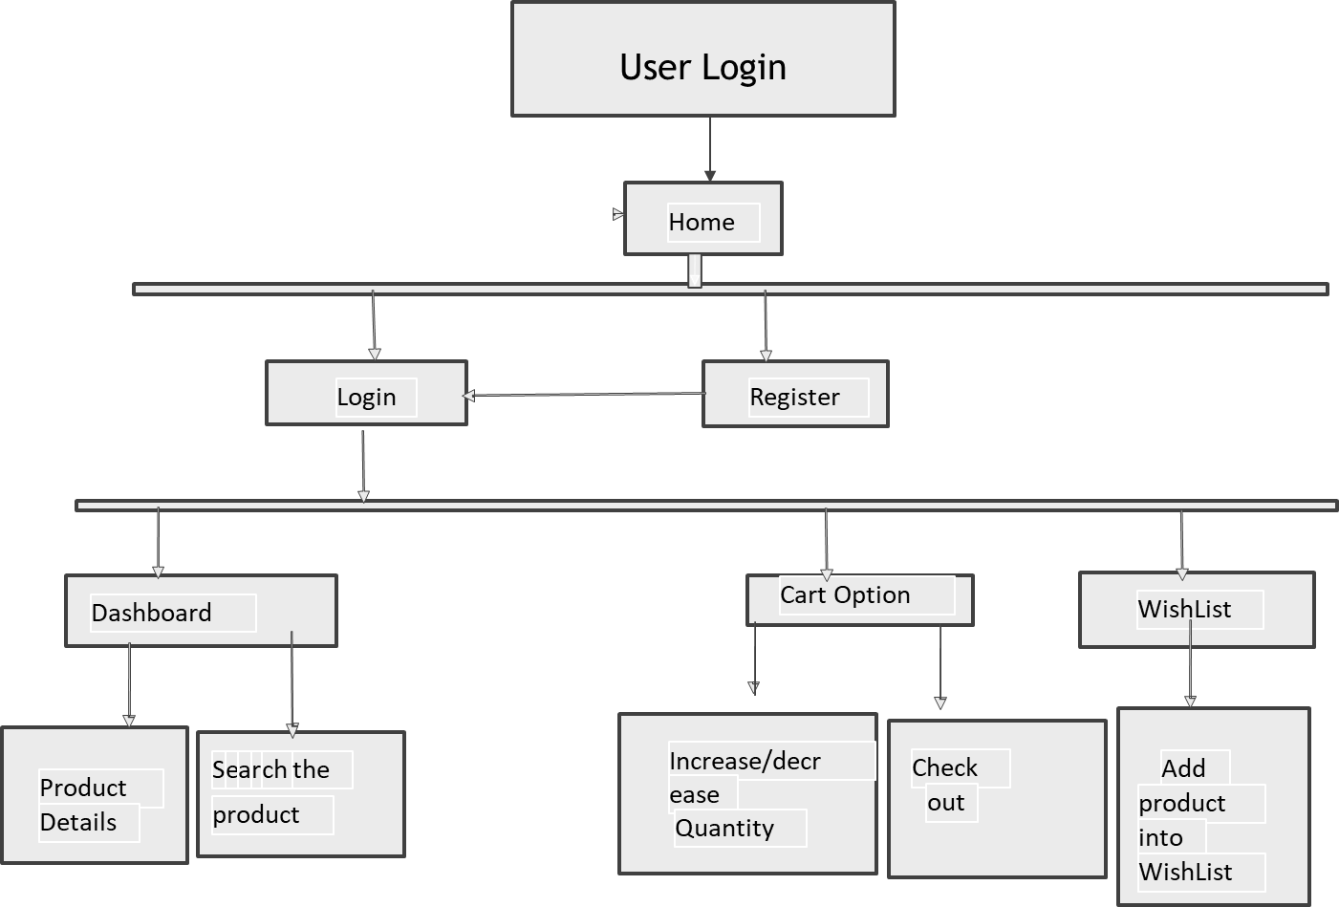
User Login Flowchart

Slide 11
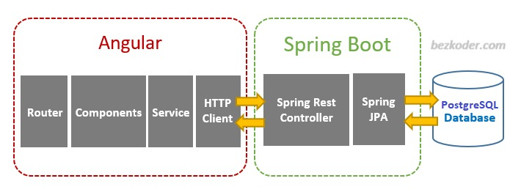
Prototype Model

Slide 12
Angular Architecture
Spring Boot Architecture
There are main eight blocks of Angular:
•Module
•Component
•Metadata
•Template
•Data Binding
•Service
•Directive
•Dependency Injection
The spring boot consists of the following four layers:
•Presentation Layer – Authentication & Json Translation
•Business Layer – Business Logic, Validation & Authorization
•Persistence Layer – Storage Logic
•Database Layer – Actual Database

Slide 13
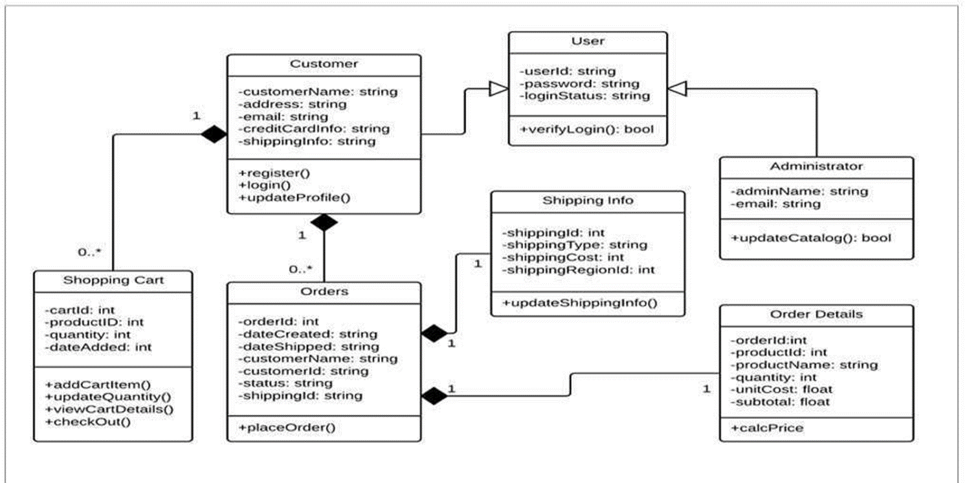
Database Class Diagram

Slide 14
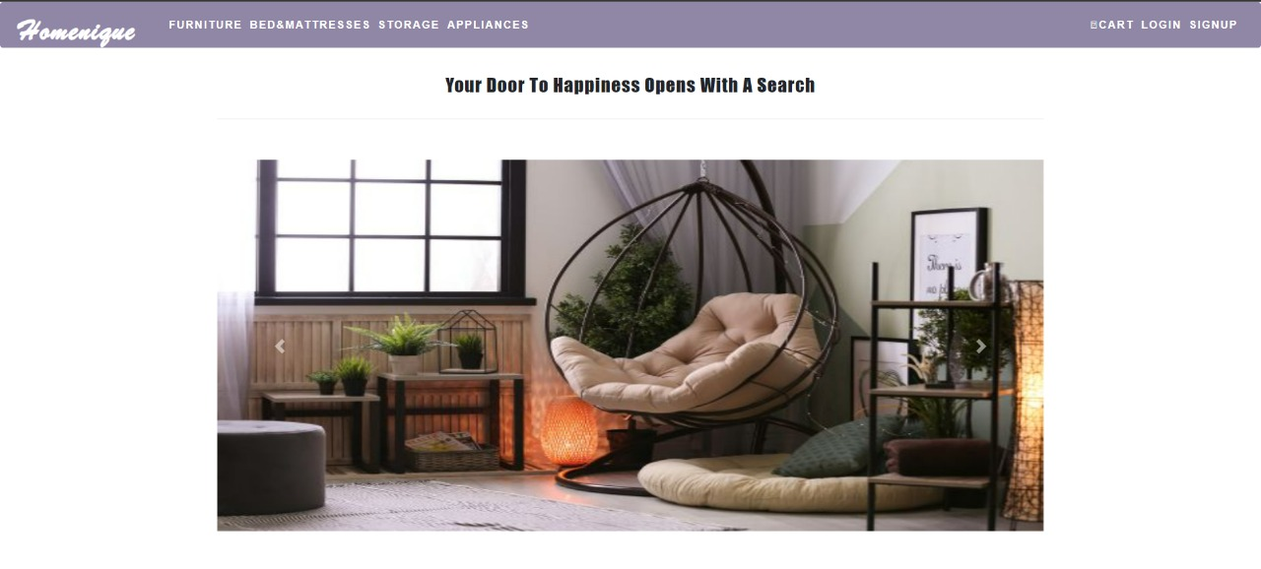
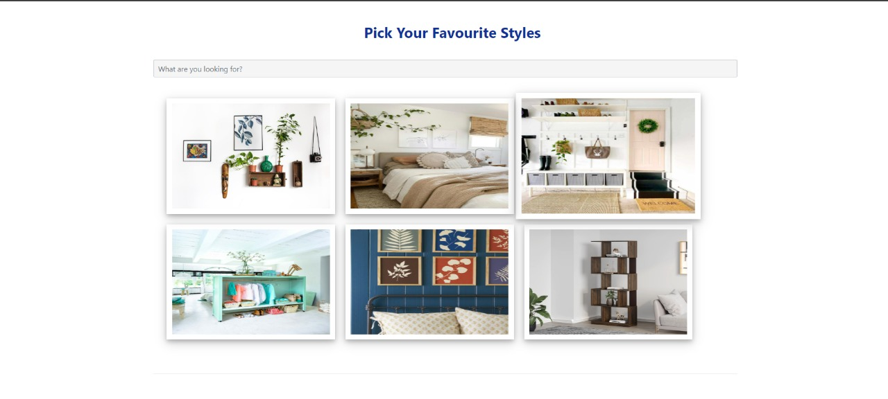
Home Page - Homenique

Slide 15
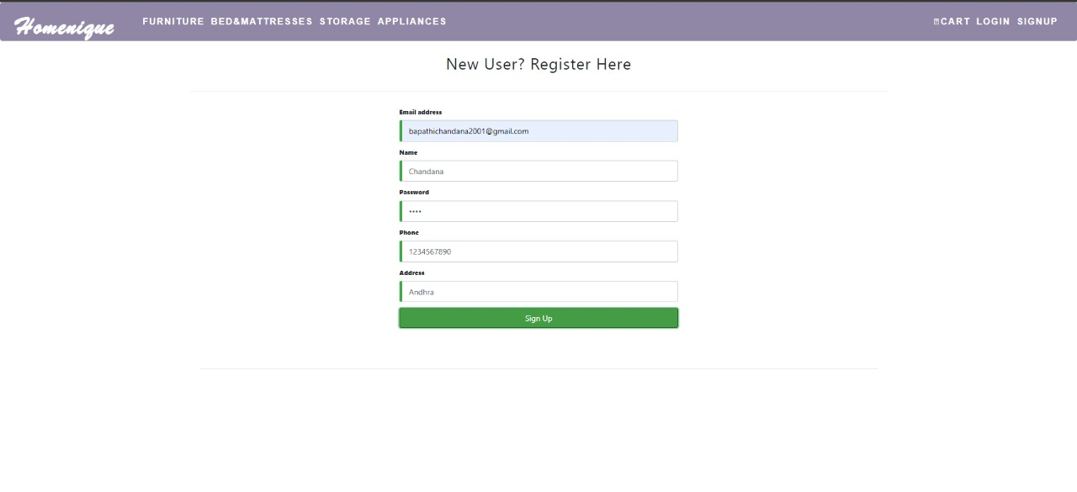
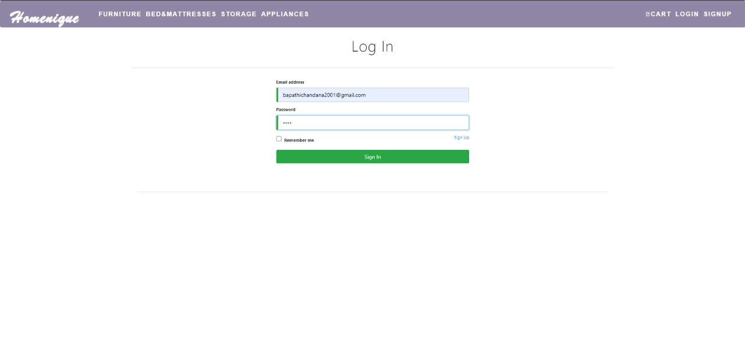
User Login & Registration panel

Slide 16
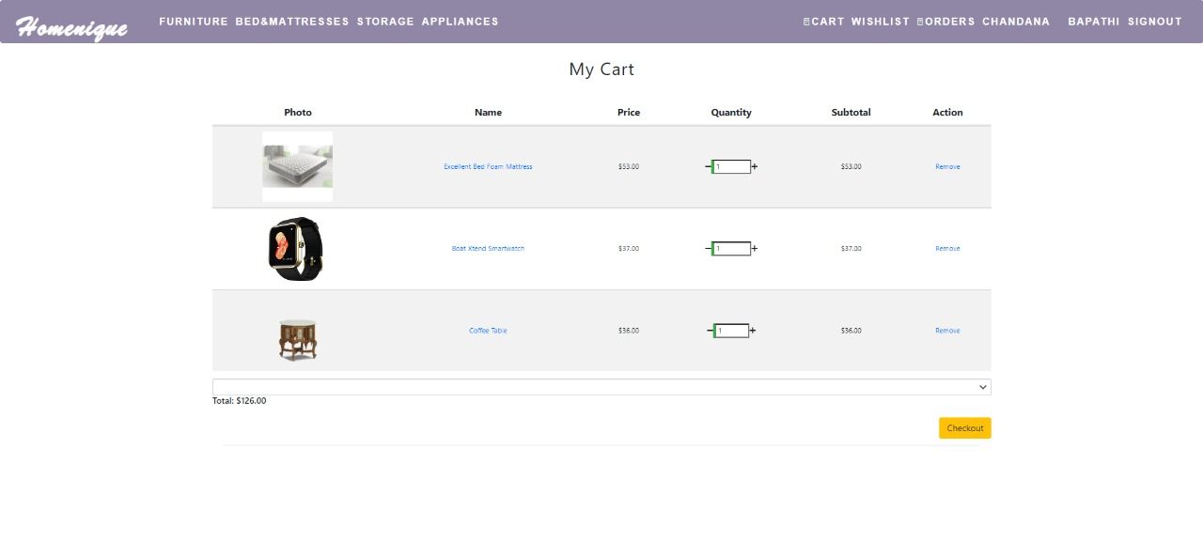
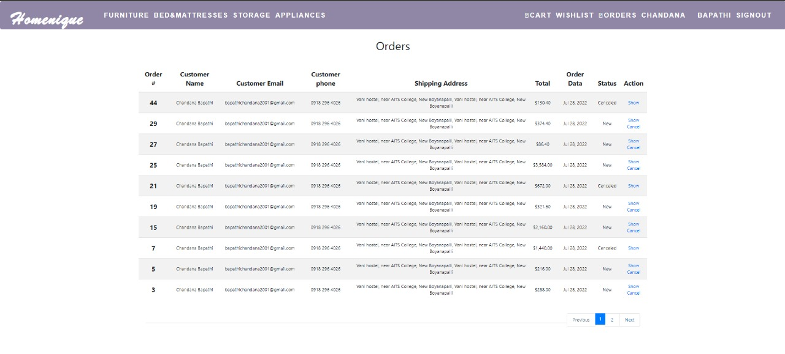
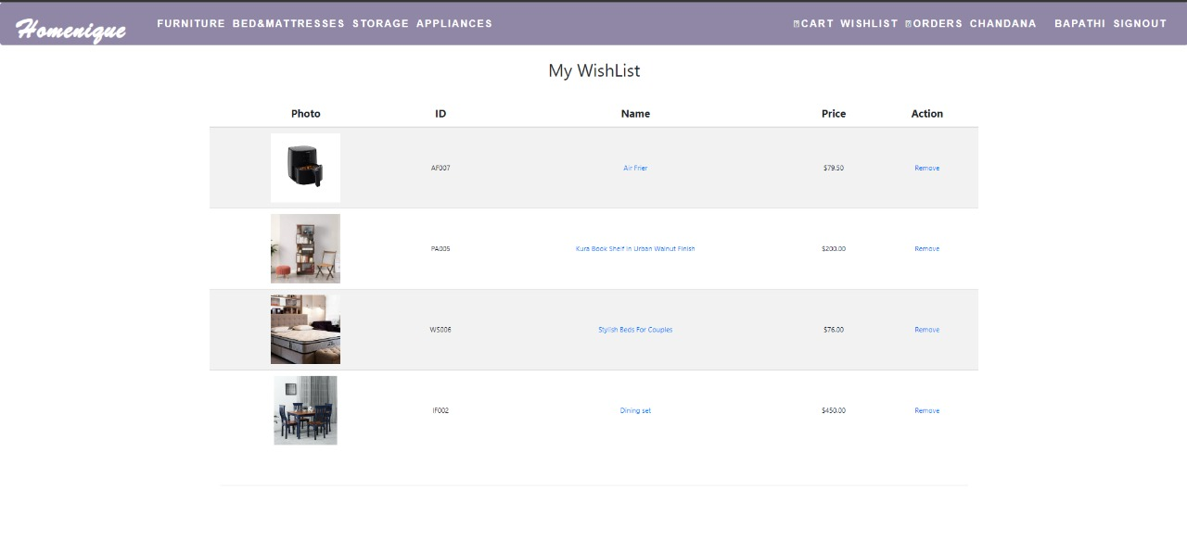
Cart - Wishlist - Orders

Slide 17
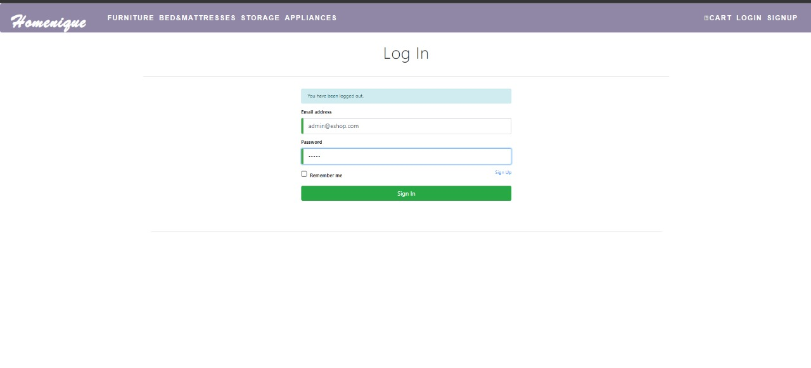
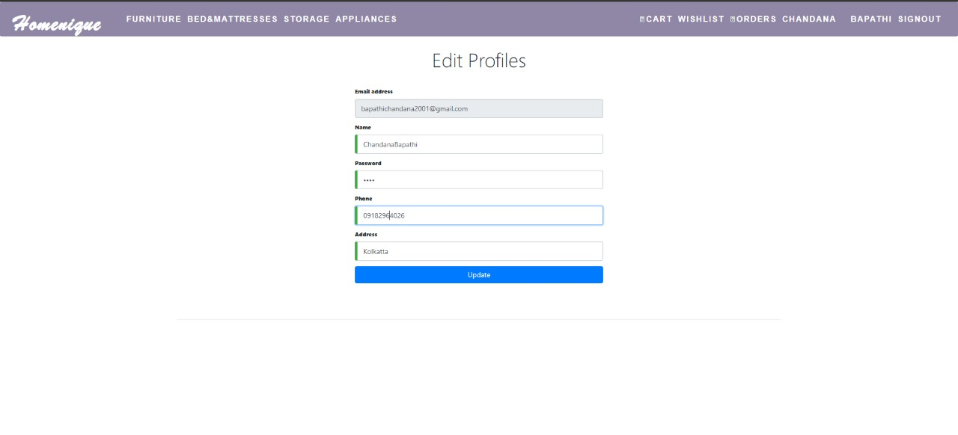
Admin Login & Profile Edit

Slide 18
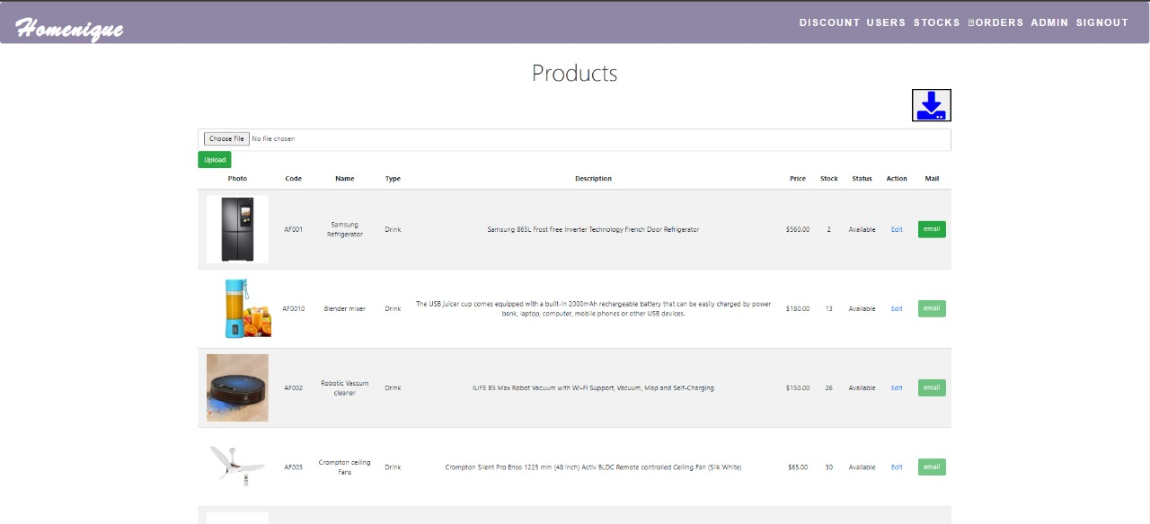
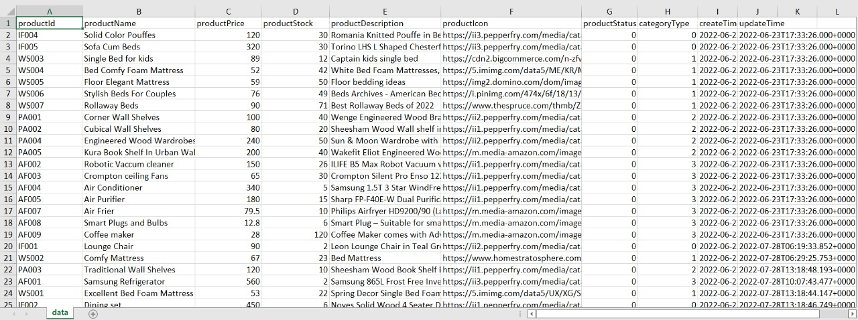
Admin - CRUD operation on Product & Stock Report

Slide 19
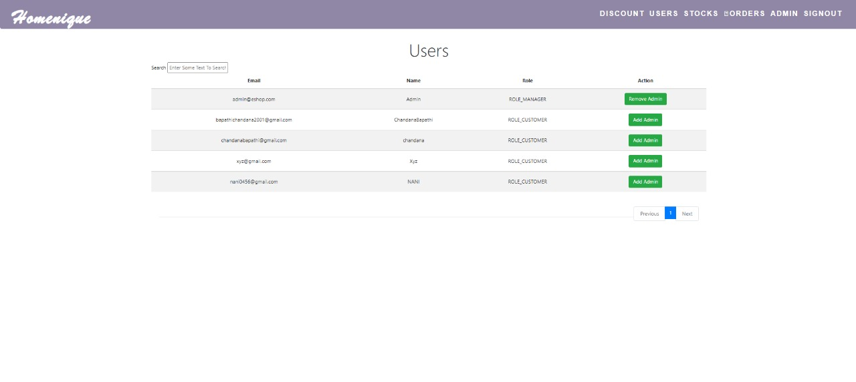
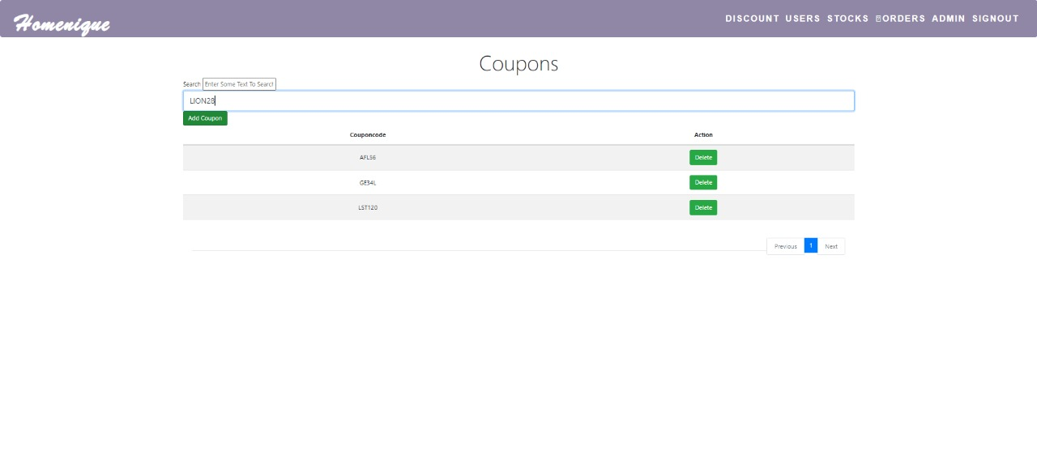
Admin - CRUD operation on User & Coupons

Slide 20
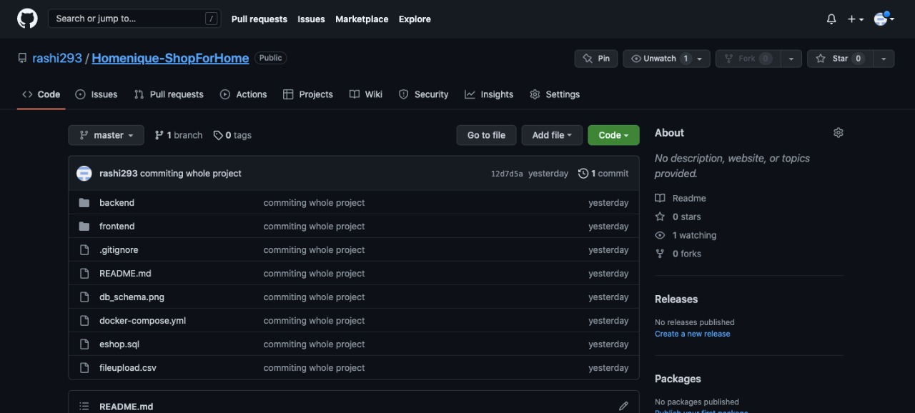
GIT Repository

Slide 21
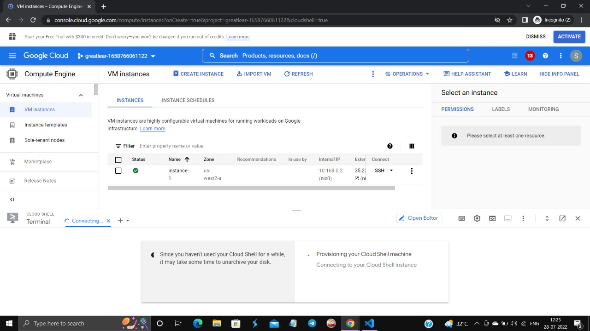
CLOUD - VM Instance

Slide 22
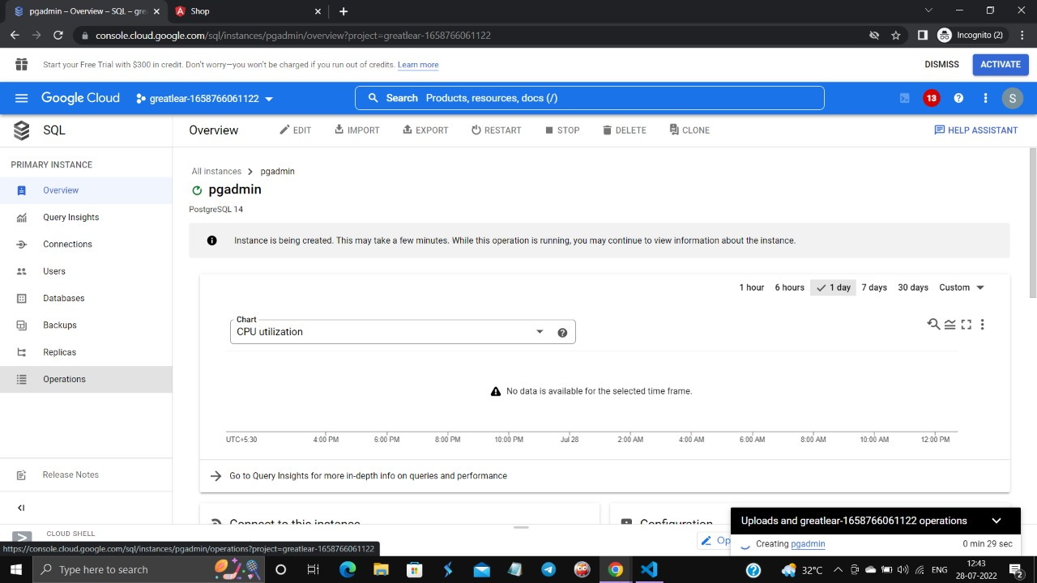
CLOUD - PostgreSql Instance

Slide 23

Link to the Demonstration:
https://drive.google.com/file/d/1DTmJKEA1mFKuffKGsAOv7-Mu8CiiPCft/view?usp=sharing

Slide 24
Thank You

